Slide 1
Don't Write Secure Code! (Build secure systems instead)
Seth Petry-Johnson @spetryjohnson

Slide 2
I hate writing secure code

Slide 3
I hate writing secure code I hate writing secure features

Slide 4
I hate writing secure code I hate writing secure features I hate implementing cross-cutting security concerns by repeating the same patterns over and over again in my feature-level code

Slide 5
What's on the agenda?
Define "cross cutting" security concerns
<x> real-world examples (.NET and JS)
???

Slide 6
"Cross cutting" concern
Any security requirement that
spans multiple features

Slide 7

"Cross cutting" concerns
Security Requirements:
User must be logged in
Users with the "Manage Orders" permission see all Orders
Everyone else sees only their own Orders

Slide 8
"Cross cutting" concerns
Security Requirements:
User must be logged in
Users with the "Manage Orders" permission see all Orders
Everyone else sees only their own Orders

Slide 9
"Cross cutting" concerns

Slide 10
"Cross cutting" concerns

Slide 11
"Cross cutting" concerns

Slide 12
"Cross cutting" concerns

Slide 13
"Cross cutting" concerns

Slide 14
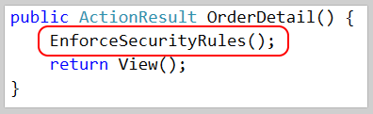
"Cross cutting" concerns

Slide 15
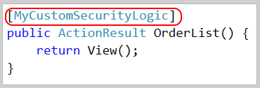
"Cross cutting" concerns

Slide 16

"Cross cutting" concerns

Slide 17
What makes a concern "cross cutting"?
Orthogonal to feature-specific business rules

Slide 18
What makes a concern "cross cutting"?
Orthogonal to feature-specific business rules
Applies to multiple features

Slide 19
What makes a concern "cross cutting"?
Orthogonal to feature-specific business rules
Applies to multiple features
Can be made "secure by default"

Slide 20
What makes a concern "cross cutting"?
Orthogonal to feature-specific business rules
Applies to multiple features
Can be made "secure by default"
Needs auditing

Slide 21
Show me the codez! bit.ly/2i0J91d

Slide 22
A1 - Injection Watch out for "little Bobby Tables"!

Slide 23
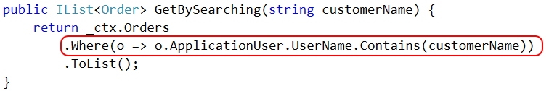

CSRF Defense – feature

Slide 24
CSRF Defense – feature
Pro tip: Concatenating raw strings into SQL queries makes you a bad person.
Don't be a bad person. Parameterize your SQL.

Slide 25
A8 – Cross Site Request Forgery Fun fact*: users never log out. Ever.
* Not actually a fact.

Slide 26
Cross Site Request Forgery (CSRF)

Slide 27
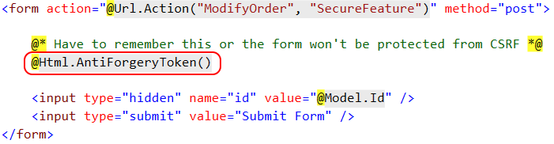
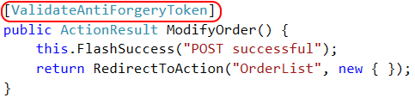
CSRF Defense – feature

Slide 28

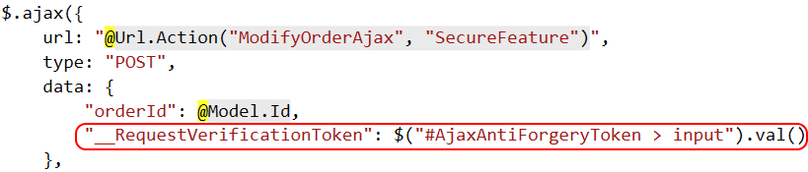
CSRF Defense – feature (ajax)

Slide 29
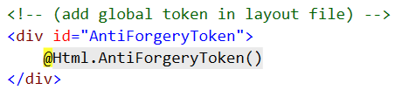
CSRF Defense – cross cutting

Slide 30
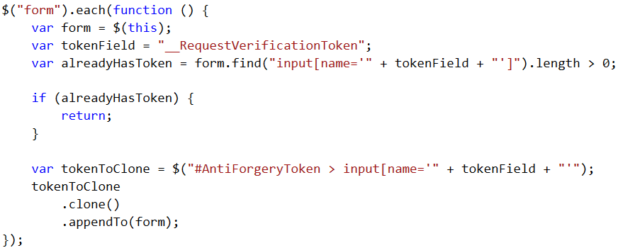
CSRF Defense – cross cutting

Slide 31
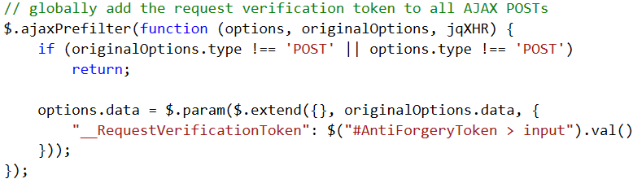
CSRF Defense – cross cutting

Slide 32
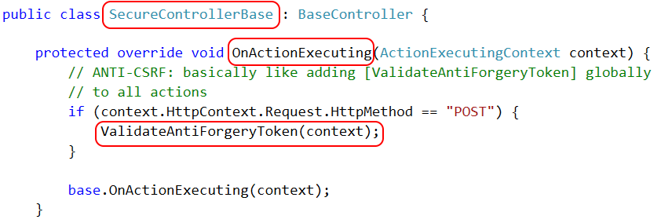
CSRF Defense – cross cutting

Slide 33

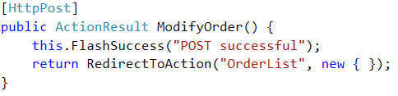
CSRF Defense – cross cutting

Slide 34
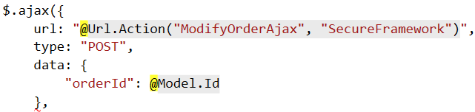
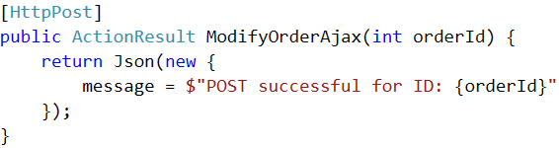
CSRF Defense – cross cutting (ajax)

Slide 35
A4 – Insecure Direct Object References A7 – Function Level Authorization Security via hidden links is weak sauce

Slide 36
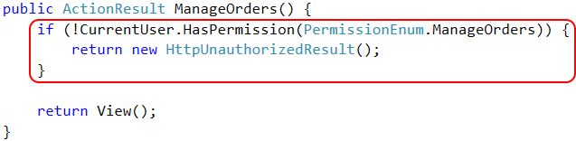
Page Authorization – feature

Slide 37

Page Authorization – cross cutting

Slide 38
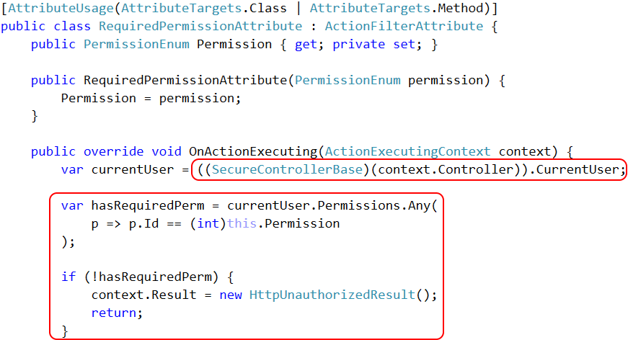

Slide 39
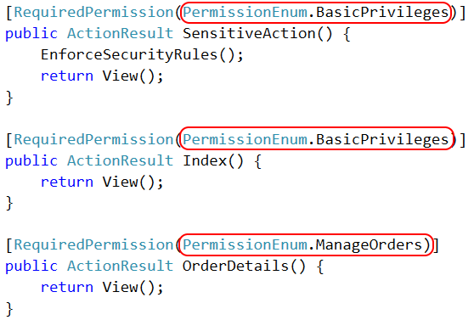
Page Authorization – auditing

Slide 40
A6 – Sensitive Data Exposure Keeping private data private!

Slide 41
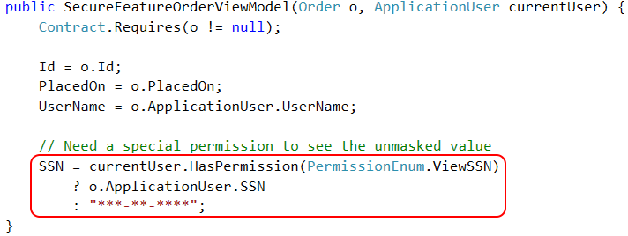
Property Authorization – feature

Slide 42
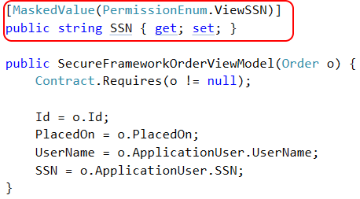
Property Authorization – cross cutting

Slide 43
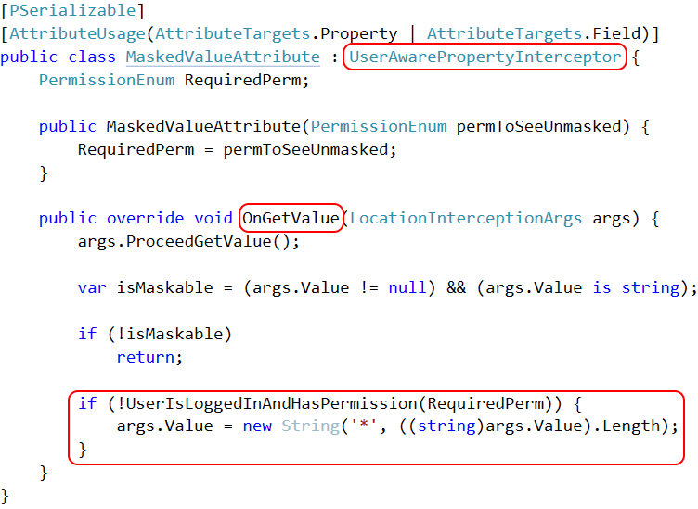

Slide 44
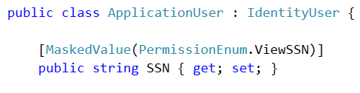
Property Authorization – cross cutting

Slide 45

Property Encryption – cross cutting

Slide 46
Access Control Keeping Bob's hands off Alice's data

Slide 47
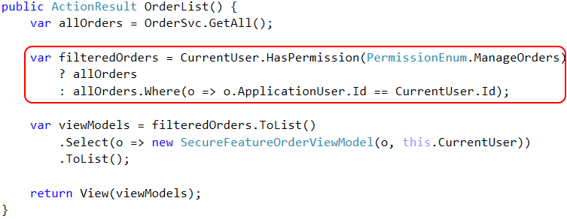
Access Control – feature

Slide 48
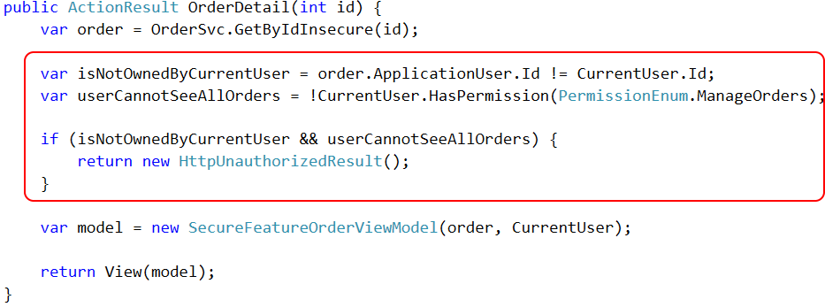
Access Control – feature

Slide 49
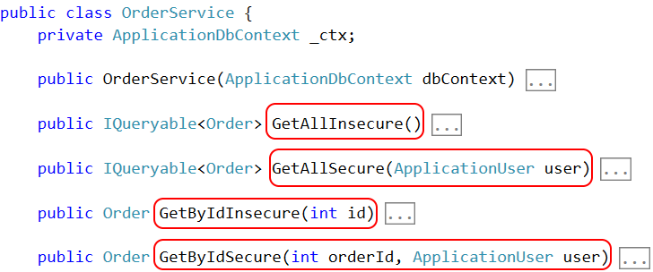
Access Control – framework

Slide 50
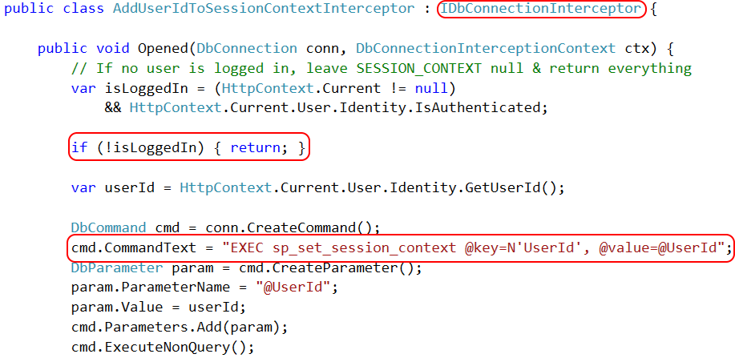
Access Control – Row Level Security

Slide 51
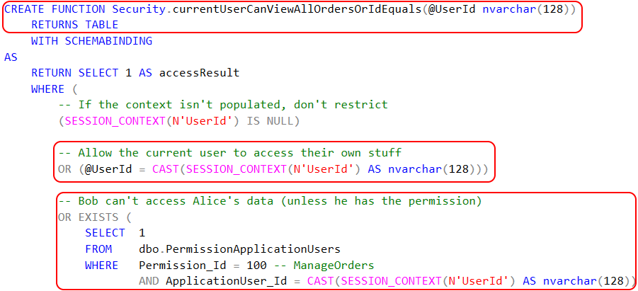
Access Control – Row Level Security

Slide 52

Access Control – Row Level Security

Slide 53
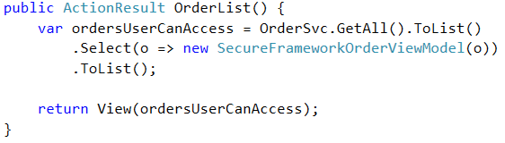
Access Control – framework

Slide 54
Patented step-by-step slide
Old news
New hotness

Slide 55
Canonical example: SQL Injection

Slide 56
Closing slide
The knowledge gets dropped here
github.com/spetryjohnson | www.petry-johnson.com
@spetryjohnson

